Slide 1
Gender inequality – economic and educational opportunities
Sherry tan / nsdai

Slide 2
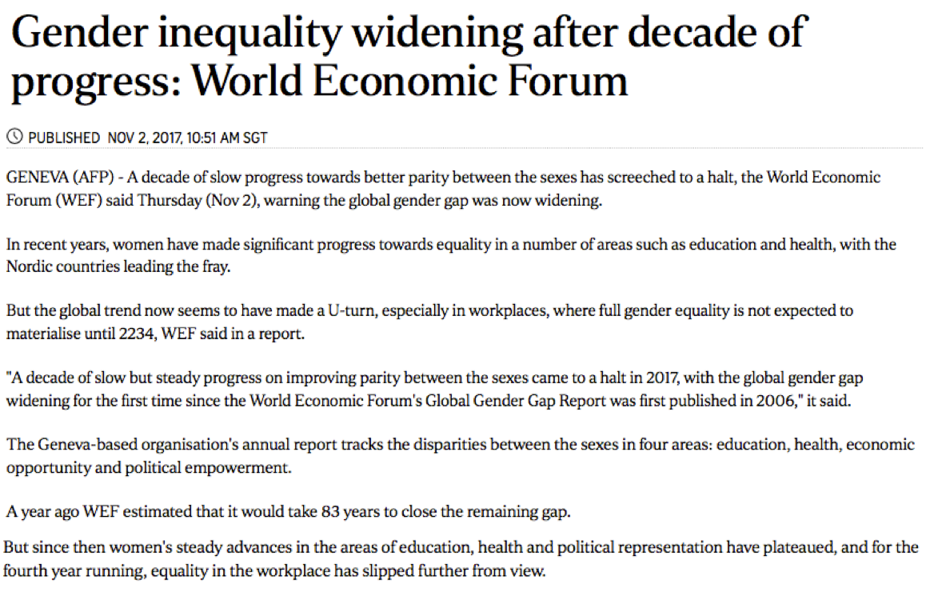
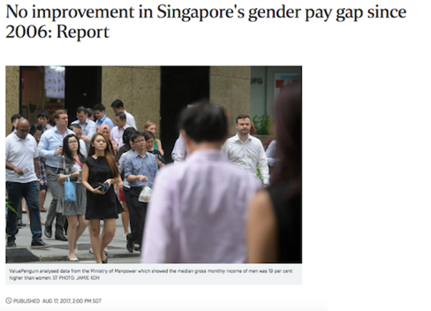
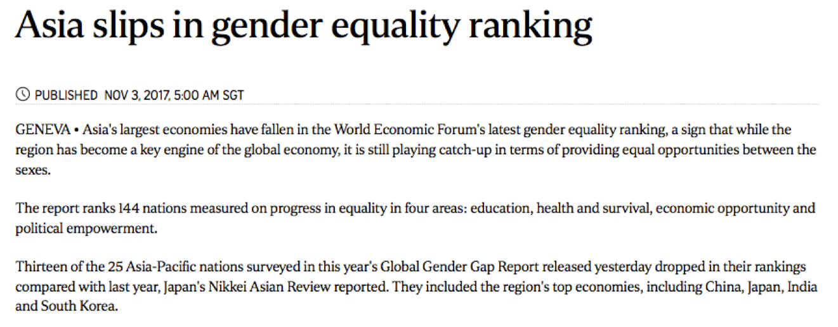
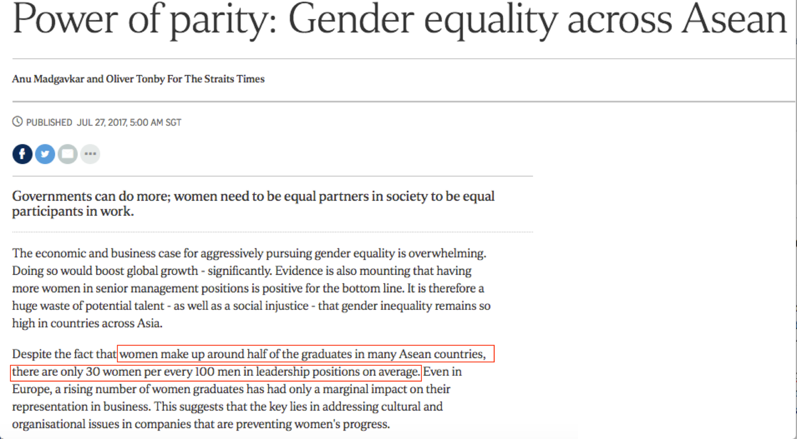
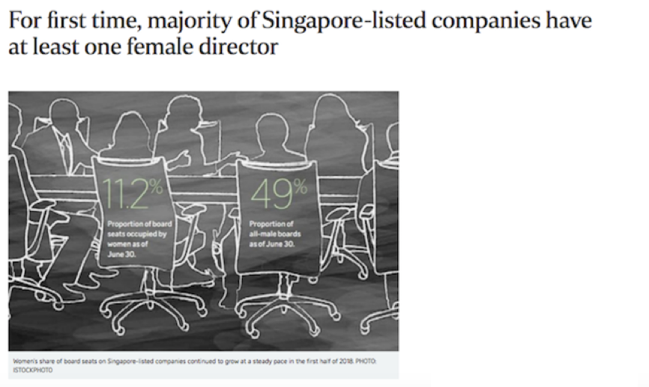
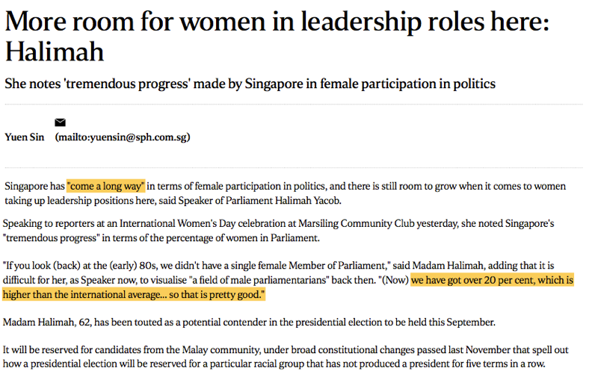
BACKGROUND

Slide 3
OBJECTIVEs
Study gender differences in Singapore
Trends in indicators such as labour force participation, tertiary education attainment
Ratio of female to male first degree graduates by type of course
Salaries for different occupations
Analyze gender indicators from world data
Benchmark Singapore’s performance against countries with similar economic, ideological or cultural profile
Trends in indicators such as gender parity in labour force participation
Investigate if correlations exist between indicators

Slide 4
Data sets

Slide 5
GENDER DIFFERENCES IN SINGAPORe
SINGAPORE TRENDS
Source | Data Sets
Data@Gov | Key Indicators On Gender, Annual Literacy Rate, Combined Gross Enrolment Ratio and Key Labour Force indicators by Sex Mean Years of Schooling & Median Age At First Marriage by Sex URL: https://data.gov.sg/dataset/key-indicators-on-gender-annual
 | Combined And Gross Enrolment Ratio For Primary, Secondary & Tertiary Education URL: https://data.gov.sg/dataset/combined-and-gross-enrolment-ratio-for-primary-secondary-tertiary-education
 | Resident Labour Force Aged 15 Years and Over by Highest Qualification Attained and Sex URL: https://data.gov.sg/dataset/resident-labour-force-aged-15-years-and-over-by-highest-qualification-attained-and-sex
 | Residents Outside the Labour Force by Highest Qualification Attained, Age and Sex URL: https://data.gov.sg/dataset/residents-outside-the-labour-force-by-highest-qualification-attained-age-and-sex
DATA SETS – SG DATA

Slide 6
GRADUATES BY COURSE
Source | Data Sets
Data@Gov | Graduates From University First Degree Courses By Type Of Course URL: https://data.gov.sg/dataset/graduates-from-university-first-degree-courses-by-type-of-course
SALARIES
Source | Data Sets
Ministry of Manpower | Median Monthly Basic and Gross Wages of Common Occupations by Sex in All Industries URL: http://stats.mom.gov.sg/Pages/Occupational-Wages-Tables2017.aspx
DATA SETS – SG DATA

Slide 7
GENDER INDICATORS FROM WORLD bank DATA
GENDER INDICATORS FROM WORLD BANK DATA
Source | Data Sets
The World Bank | All Gender Indicators URL: http://datatopics.worldbank.org/gender/ Current Classification by Income in XLS format URL: https://datahelpdesk.worldbank.org/knowledgebase/articles/906519-world-bank-country-and-lending-groups
DATA SETS – WORLD BANK DATA

Slide 8
DATA EXPLORATION & PREPARATION

Slide 9
DATA EXPLORATION
Key Indicators on gender
Data covered years 1970 – 2017
Before year 2000, data was only available in the years of 1970, 1980, 1990, 1995. From year 2000 onwards, data was available yearly
Values for each year and each gender group were given for the indicators:
Resident Labour force participation rate (%)
Combined Gross enrolment ratio (%)
Literacy rate (15 years & over) (%)
Proportion of PMETs among employed residents (15 years & over) (%)
Mean Years of Schooling (25 Years & Over)
Median Age at First Marriage
For labour force indicators, data from 1970 – 2000 and 2005 were not comparable to other years due to differences in collection methodology and coverage. These years will be excluded from analysis
For consistency, only data from year 2001 onwards will be used for analysis of other indicators
DATA EXPLORATION – SG DATA

Slide 10
Combined And Gross Enrolment Ratio For Primary, Secondary & Tertiary Education
Data covered years 1990 – 2016
Gross enrolment ratios were given by year, level of education and gender group
Level of education included: Primary; Secondary; Tertiary; All Levels (aggregated over all levels)
Gross enrolment ratio is the number of pupils enrolled in a given education level regardless of age, expressed as a percentage of population in the theoretical age group for that level of education. Therefore, some values were greater than 100%
Data from Year 2001 onwards will be used to be consistent with analysis of other key indicators
DATA EXPLORATION – SG DATA

Slide 11
Residents in labour force by highest qualification attained and sex
Data covered years 1991 – 2015
Number of residents in labour force was given by year, gender and highest qualification attained
Residents outside labour force by highest qualification attained and sex
Data covered years 2010 – 2015
Number of residents outside labour force was given by year, gender, highest qualification and age group
The data will be aggregated across age groups and merged with the residents in labour force dataset
New columns will be created on the combined data to give, for each gender and year:
- percentage in labour force by highest qualification attained
- percentage of residents who attained that qualification
These datasets will be used for line charts to show Singapore’s trends in gender differences.
DATA EXPLORATION – SG DATA

Slide 12
Graduates From University First Degree Courses By Type Of Course
Data covered years 1993 - 2014
Number of graduates was given by type of course and gender in long format
The data will be reshaped to have individual columns for males and females to facilitate calculation of the ratio of female to male graduates
The total numbers of female and male graduates for each year will be calculated and appended to the dataframe
This dataset will be used for bar charts comparing the ratio of female to male graduates for each course
DATA EXPLORATION – SG DATA

Slide 13
Median Monthly Basic and Gross Wages of Common Occupations by Sex in All Industries
Median wages in 2017 were given by gender and occupation
The occupations were grouped under one of 9 major occupational groups
For the occupational group ‘Agricultural and Fishery Workers’, wages were available for only one occupation, and there was no data for females. As there is only 1 observation, it will be excluded in plots comparing the distribution of wages by occupational group
This dataset will be used for histograms and boxplots to compare salary distribution between genders
This dataset was also stored on an SQL database.
DATA EXPLORATION – SG DATA

Slide 14
Gender Statistics from World Bank
Data covered years 1960 to 2017
Data for 505 indicators were given for each year, for 218 countries
Aggregated data was also given for clusters of countries grouped by geographical region/income level
An initial list of 26 indicators will be selected for analysis. This is based on indicators available in the Singapore data, as well as indicators that look interesting such ‘Proportion of women in ministerial level positions’
Where indicators are given separately for females and males, the gender parity index (GPI) will be calculated i.e. Value(Female) / Value(Male) * 100%
2 subsets of data will be created – country data (data for individual countries) and cluster data (data for clusters of countries)
DATA EXPLORATION – WORLD BANK DATA

Slide 15
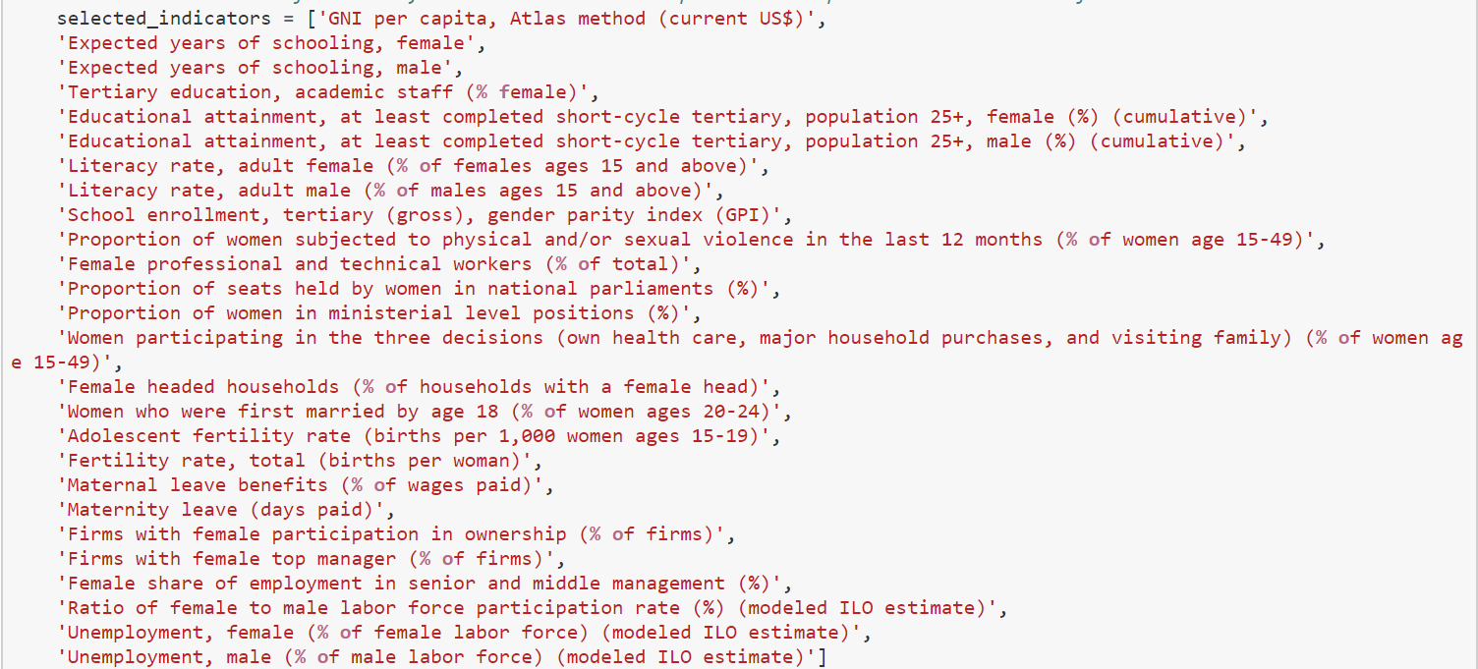
(definitions are provided in the Annex)
Indicators selected
DATA EXPLORATION – WORLD BANK DATA

Slide 16
Current Classification by Income in XLS format
Provides mapping of countries to one of 7 geographical regions.
This data will be used to map countries in the country data subset to their respective geographical regions to facilitate scatter plot analysis
Country data will be used in interactive scatter plots to compare countries, benchmark Singapore’s performance and to investigate correlations between indicators.
Cluster data will be used in line charts to study trends for gender indicators.
DATA EXPLORATION – WORLD BANK DATA

Slide 17
DATA PREPARATION
Transform and clean data:
Pandas and numpy were used to process each data set i.e.
Subset data e.g. slicing data to get years of interest
Cleaned and transformed data:
.apply() on columns for element-wise operations such as .split();
.drop() to remove redundant columns
.groupby() where operations such as .sum() or .fillna() need to be done by groups
Reshaped data e.g. pd.pivot(), pd.melt(), pd.set_index(), pd.reset_index(), pd.unstack()
Consolidated or merged data by using pd.concat () and pd.merge()
Note: Examples of dataframes before and after transformation/cleaning are in the Annex. Detailed explanations of steps taken can be found in the Jupyter notebooks.
DATA PREPARATION

Slide 18
Additional considerations for World Bank data:
COUNTRY DATA
There were many NaN values for some of the 26 indicators.
As the aim was to study the current situation and not look at yearly trends, a short 5 - year range of the latest years, 2012 – 2017, was considered for analysis
Forward fill was then used to replace NaN values for each country by using .groupby() with .fillna(). The assumption was that values for any indicator would not change drastically from one year to the next.
The short time frame ensured that values from many years ago would not be propagated to 2017, which would be highly inaccurate for cases with a huge chunk of consecutive NaNs in the intervening years.
Indicators that had more than 50% NaN values were dropped from further analysis, as it would not be meaningful to draw correlations with limited data
Gross national income (GNI) per capita, though not a gender indicator, tends to be closely linked with social, economic and environmental well-being. It was therefore retained in the dataset.
DATA PREPARATION – WORLD BANK DATA

Slide 19
CLUSTER DATA
Cluster data was subset to include only years 2001 – 2017, in line with the time frame used for the SG trends data.
FINAL LIST OF INDICATORS USED FOR PLOTS:
Country Data
Cluster Data
Note: indicator names, as reflected above, had been shortened so that they would not clutter the plots.
DATA PREPARATION – WORLD BANK DATA

Slide 20
DATA VISUALIZATION
methods

Slide 21
DATA VISUALIZATION - METHODS
Charts | Libraries/functions used
Line charts Singapore trends | matplotlib.pyplot/ .plot() Line charts of value vs year were plotted for each indicator by looping over consolidated dataset and color-coding by gender
Bar charts Ratio of female to male graduates by course | seaborn/ .barplot() A bar chart function was created to plot horizontal bar charts showing type of course vs ratio. The ‘hue’ argument was used to set bar color; this allowed for flexibility in plotting charts for data subsets containing only 1 year, or multiple years. axvline() was used to plot a vertical line at x = 1 as a reference line for gender parity.
Histograms Median salaries by gender | seaborn/ .FacetGrid(), plt.hist FacetGrid was used to display histograms for each gender in columnar format for comparison
METHODS – SG DATA

Slide 22
Charts | Libraries/functions used
Boxplots Median salaries by occupational group and gender | seaborn/ .boxplot() Arguments in boxplot were set to control aesthetics and colour by gender. Occupational group was specified as the y-axis to allow comparison by group.
METHODS – SG DATA

Slide 23
Charts | Libraries/functions used
Heatmap Correlation between indicators | seaborn/ .heatmap() pd.corr() was used to calculate correlation between indicators, and visualized as a heatmap. For visual clarity, the mask argument was employed to remove redundant pairs (i.e. the upper triangle and diagonal)
Interactive plots Scatter plots: Country comparison Line charts: Cluster trends | Bokeh Interactivity was built into plots by using HoverTool(): Gives additional information when mousing over a data point Widgets such as Slider(), Select(), CheckboxGroup() and an update function to get user inputs and update plots ColumnDataSource() to create plot data that could be updated by user inputs .circle() glyphs for scatterplots and .multi_line() glyphs for line charts Widgets such as Tabs(), Panel() to create a tabbed display in bokeh app
METHODS – WORLD BANK DATA

Slide 24
DATA VISUALIZATION
key findings

Slide 25
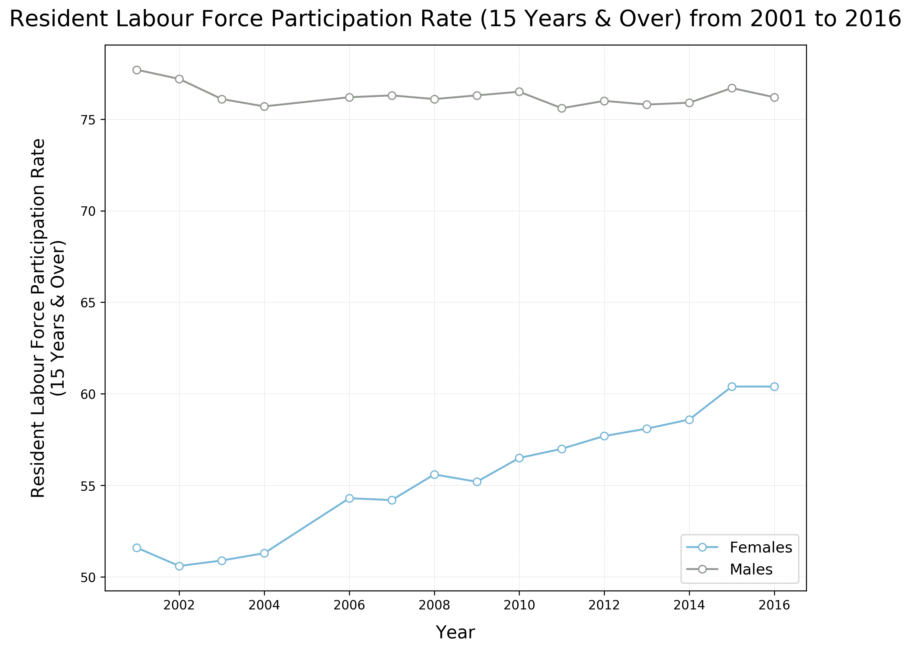
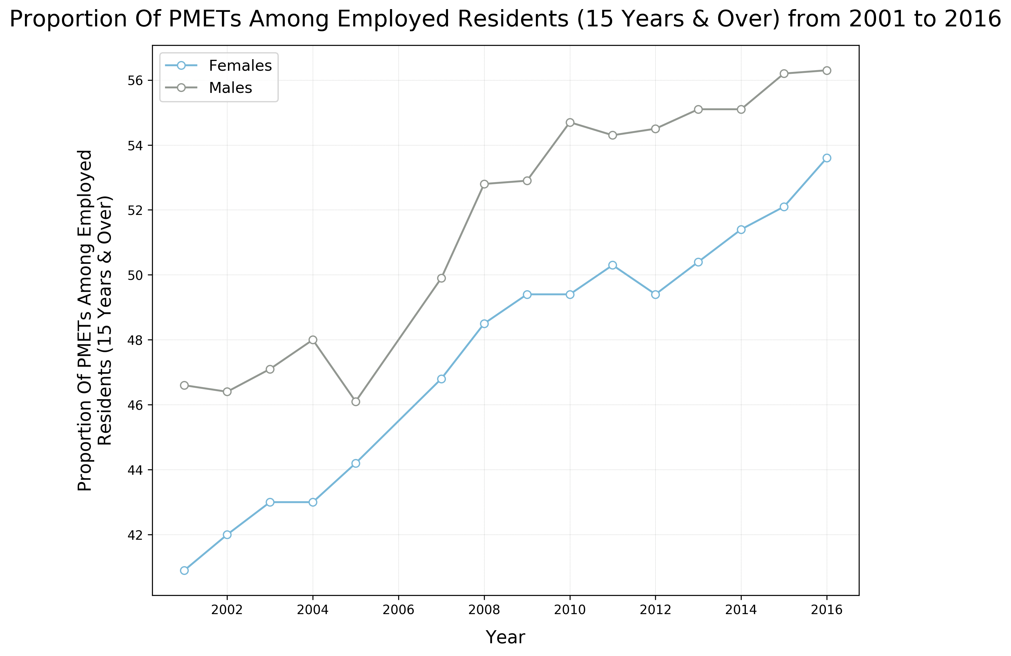
Females in Singapore continue to lag behind males in most indicators by 1-2 %.
For labour force participation, the gender gap has narrowed in recent years. However, the current gender disparity is significant, at more than 15%.
Labour Force Participation Rate
Proportion of PMETs
FINDINGS

Slide 26
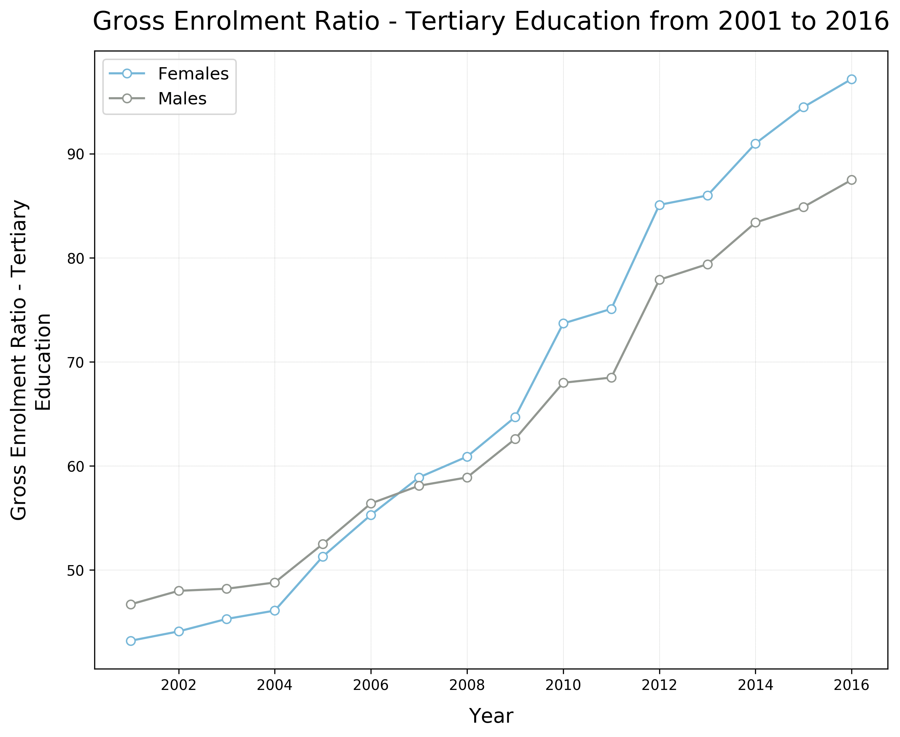
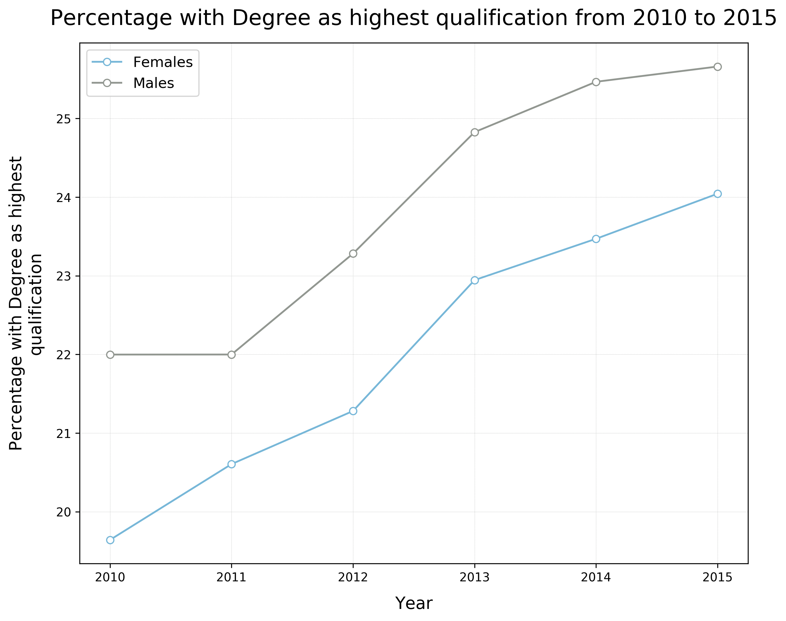
An exception is enrolment in tertiary education, where females overtook males in 2007.
Gross Enrolment in Tertiary Education
Proportion with degrees
FINDINGS

Slide 27
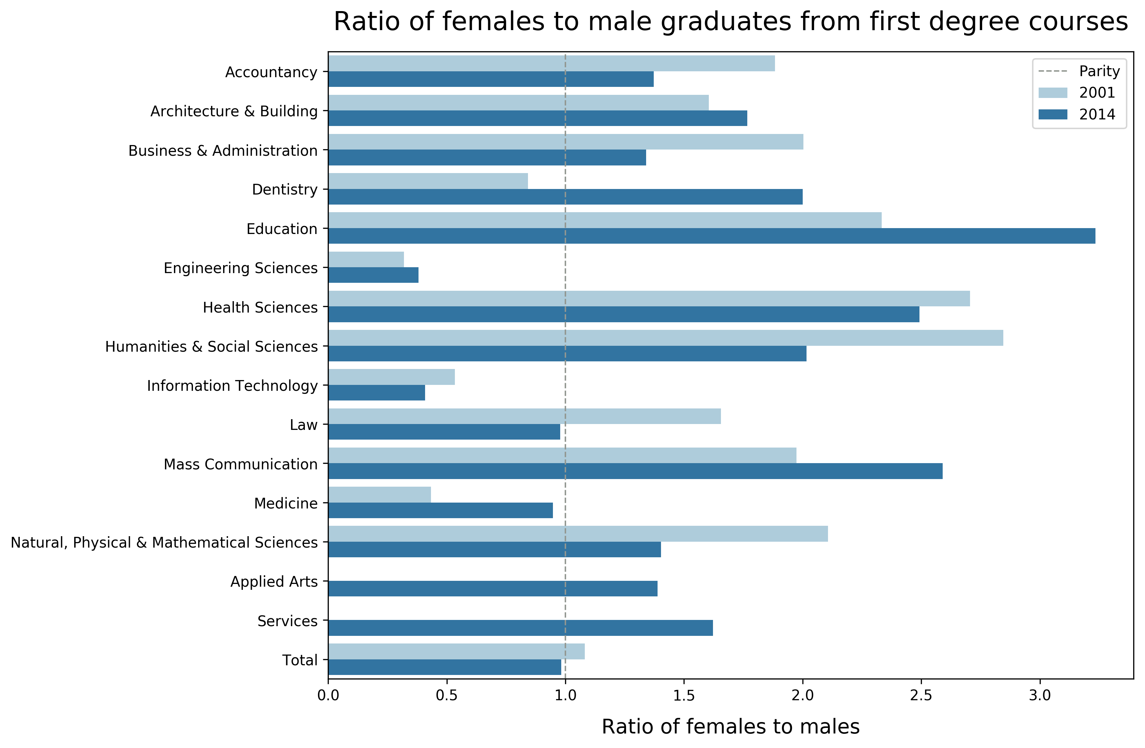
Gender parity in the number of degree graduates improved for some STEM courses (Medicine, Dentistry), but not others (Engineering, IT).
FINDINGS

Slide 28
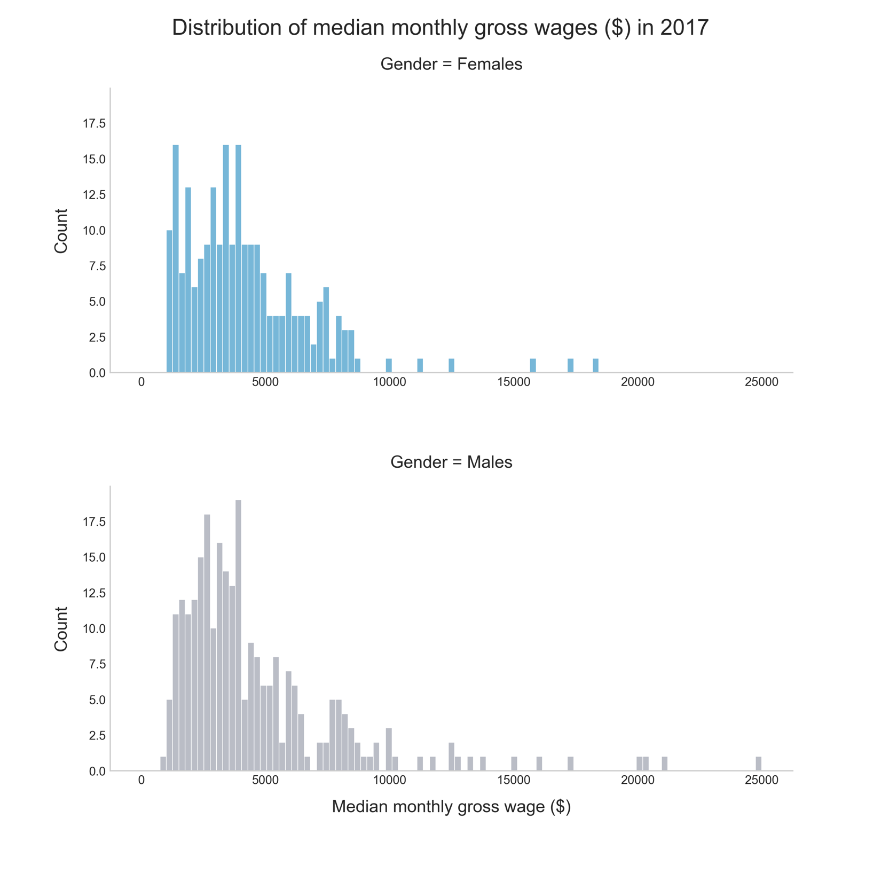
Salaries for females continued to lag behind their male counterparts in 2017.
FINDINGS

Slide 29
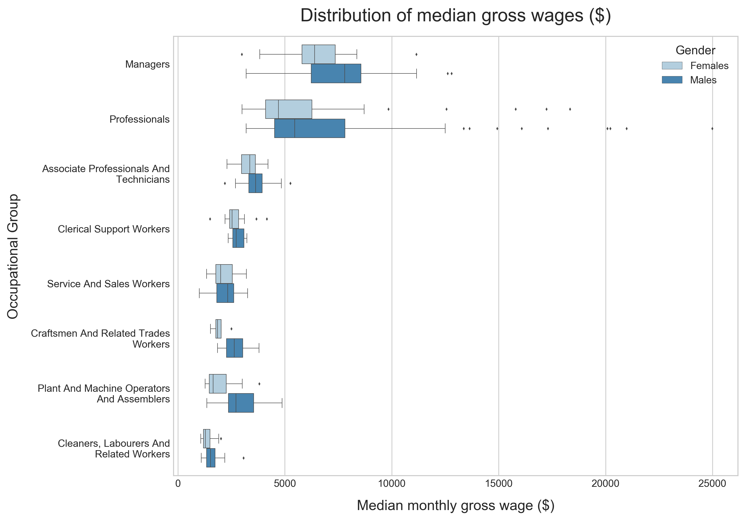
…with the disparity being particularly pronounced for managerial, technical and professional occupations.
FINDINGS

Slide 30
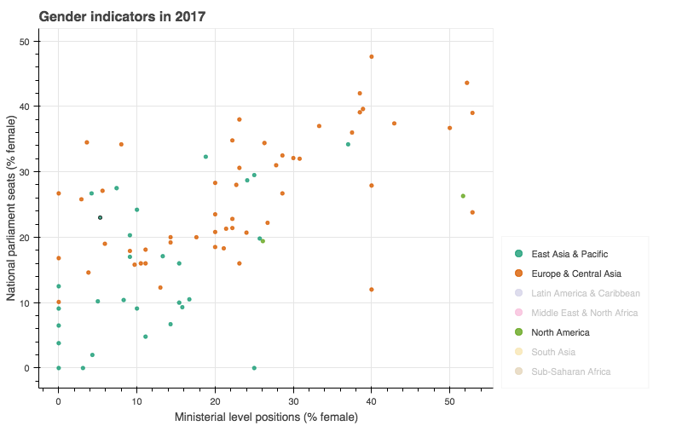
Compared with countries of similar profile, Singapore lags behind many in…..
Female representation in politics
Compared to SG, many countries fare better with female representation in parliamentary and/or ministerial positions.
SG
Note: Data points for regions that are culturally or economically dissimilar from Singapore have been excluded for clarity
FINDINGS

Slide 31
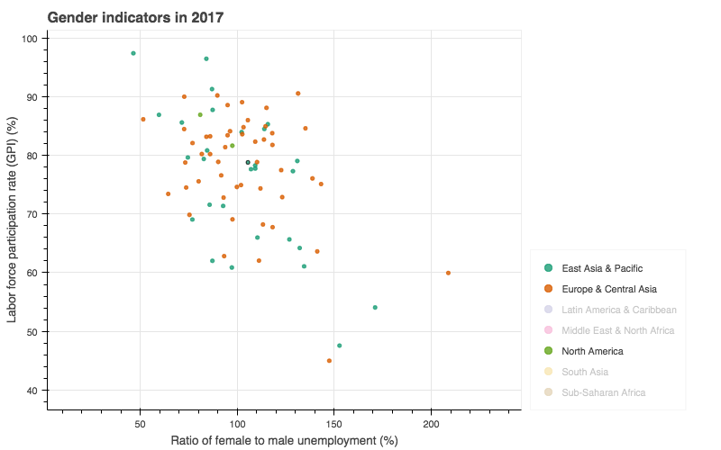
Labour force participation GPI
Countries with higher GPI include Vietnam, Laos, Cambodia, Australia and Korea
SG
Note: Data points for regions that are culturally or economically dissimilar from Singapore have been excluded for clarity
FINDINGS

Slide 32
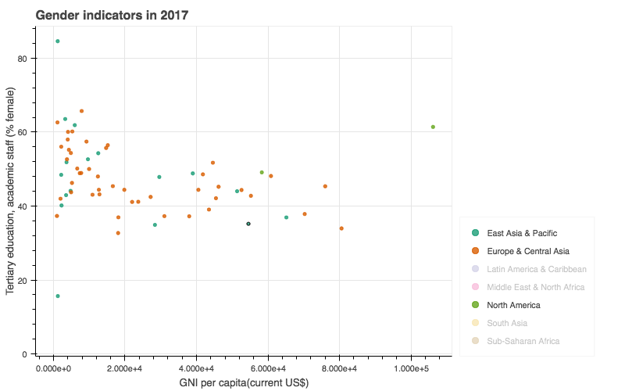
Female representation in tertiary academia
Most countries, including those with lower GNI, have higher female representation in tertiary academia
SG
Note: Data points for regions that are culturally or economically dissimilar from Singapore have been excluded for clarity
FINDINGS

Slide 33
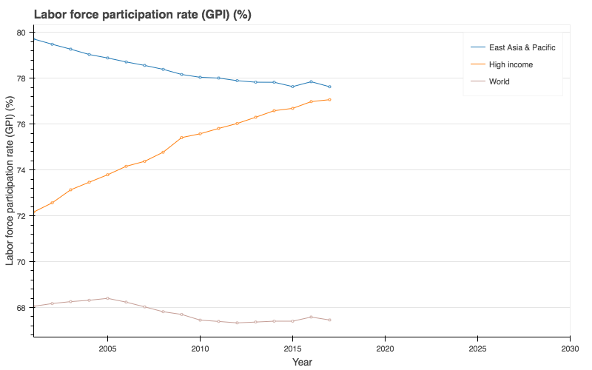
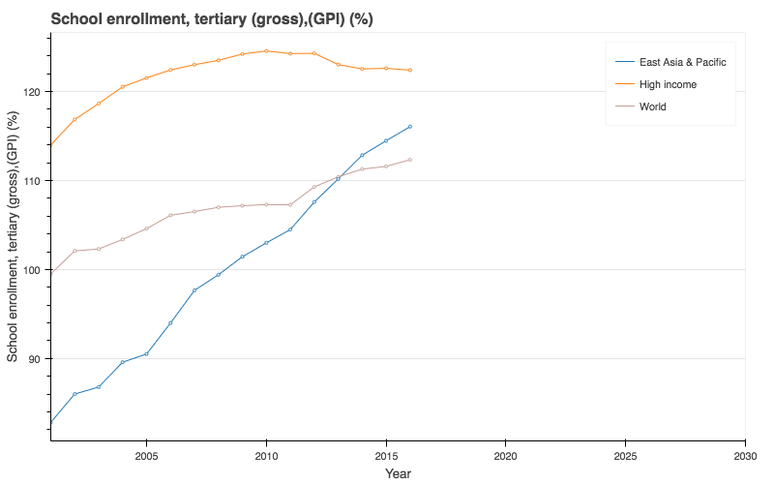
Gender parity index (GPI) in labor force participation rate is trending upwards for high – income countries, similar to what was observed earlier for Singapore. However, there appears to be a slight downward trend in the East Asia & Pacific region. GPI of greater than 100% in tertiary enrolment rate appears to be a worldwide trend not peculiar to Singapore.
FINDINGS

Slide 34
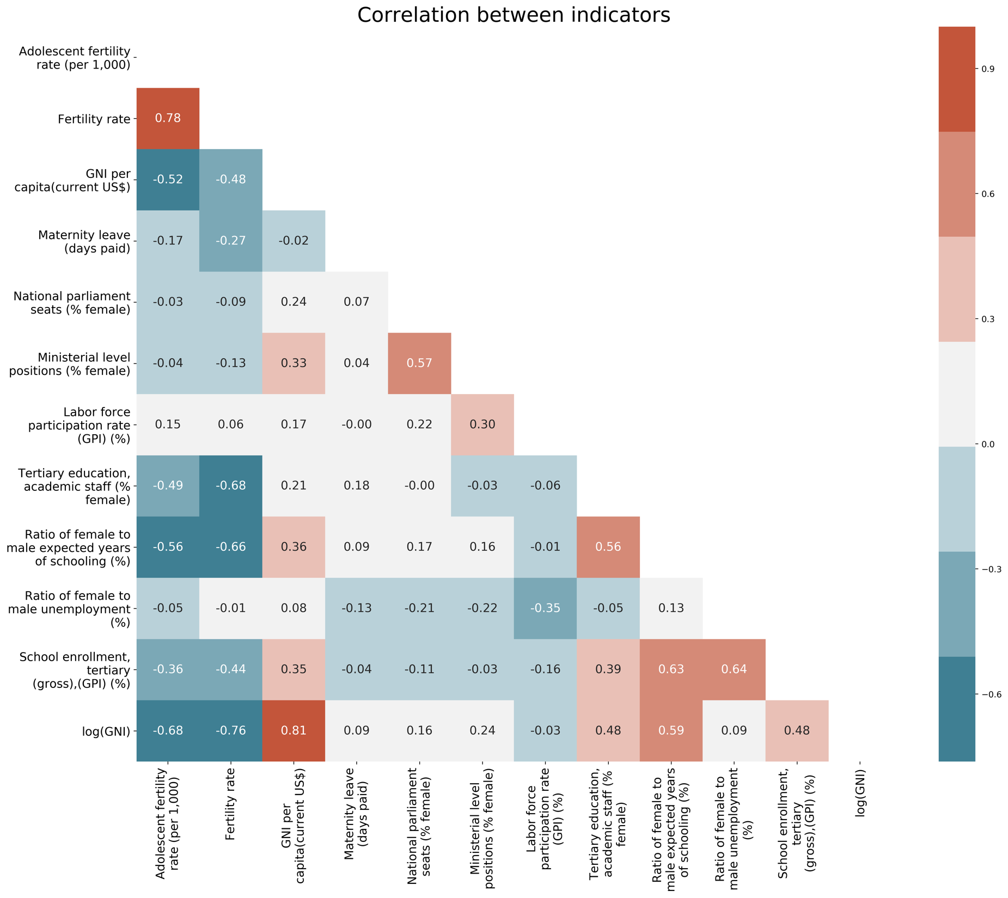
Correlations were also found between some indicators, which may give useful clues for tackling gender disparity.
But…
FINDINGS

Slide 35
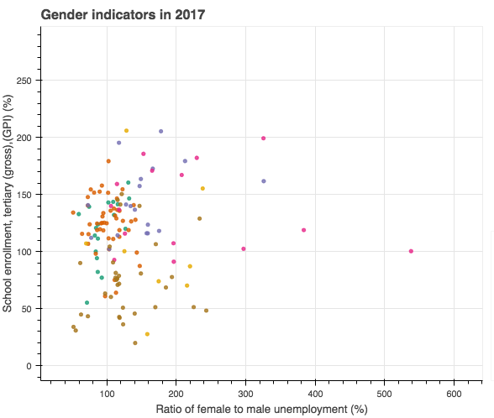
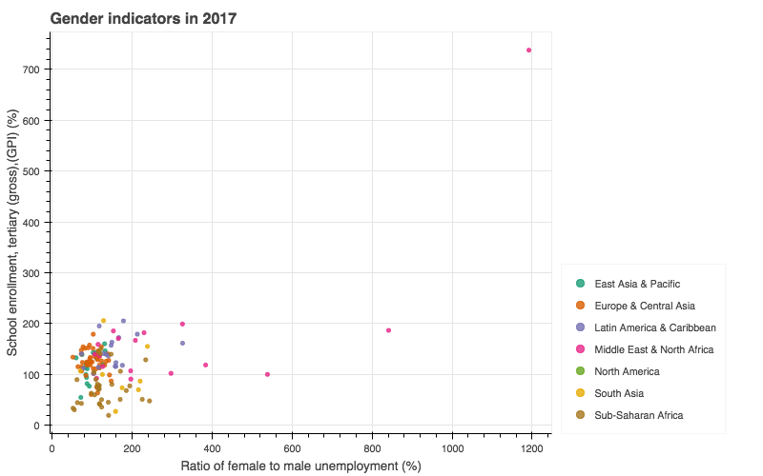
Correlations may be affected by outliers
No
correlation?
Qatar
Positive correlation?
It is still necessary to look at individual data points to get the entire picture
FINDINGS

Slide 36
conclusions
Gender inequality in Singapore persists, especially in labor force participation and wages
Females have surpassed males in tertiary enrolment rate. This, however, is a worldwide trend and not peculiar to Singapore. It remains to be seen whether this will eventually translate to equality in economic opportunities
The number of female graduates from traditionally male-dominated technical degree courses is still disproportionately low
President Halimah had commented that Singapore’s female representation of more than 20% in Parliament was above the world average, and therefore ‘pretty good’
However, compared to countries with similar cultural, economic or ideological profile, Singapore lags behind in labour force participation and female representation in politics.
Gender equality in Singapore is very much a work in progress…perhaps Singapore could look to its better-performing counterparts for inspiration!
Findings on correlations between indicators were not conclusive; analysis could be repeated after removing outliers, or conducted on individual regions
FINDINGS

Slide 37
THANK YOU!

Slide 38
annex

Slide 39
Notebooks and python files
Charts | Notebooks / Python Files
Line charts: Singapore trends | SG_trends.ipynb
Bar charts: Ratio of female to male graduates by course | SG_GraduatesByCourse.ipynb
Histograms: Distribution of median salaries by gender Boxplots: Distribution of median salaries by occupational group and gender SQL: Storing and retrieving data | SG_salary.ipynb
Heatmap: Correlation between indicators Scatter plots: Relationships between indicators, country comparison Line charts: Trends for different clusters | world_data.ipynb
Bokeh Application: Tabbed display of scatter plot and line chart | worlddata_app bokeh serve --show worlddata_app
ANNEX

Slide 40
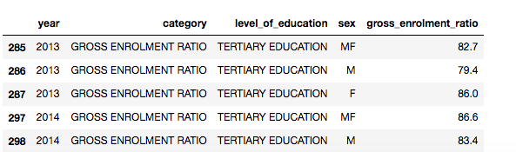
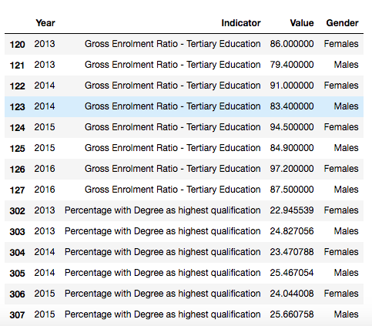
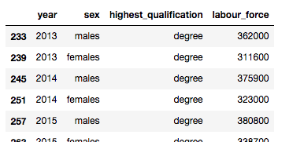
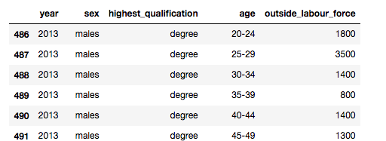
DATA FRAMES BEFORE AND AFTER TRANSFORMATION
SINGAPORE TRENDS
Before transformation | After transformation
ANNEX

Slide 41
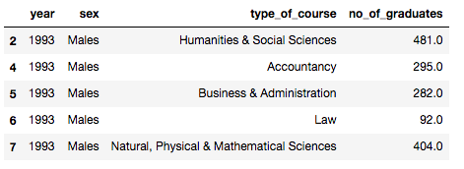
GRADUATES BY COURSE
Before transformation | After transformation
ANNEX

Slide 42
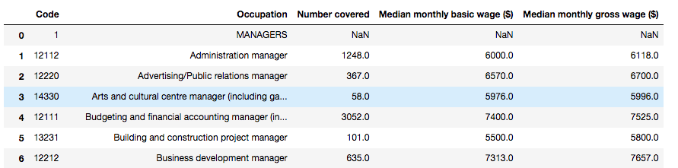
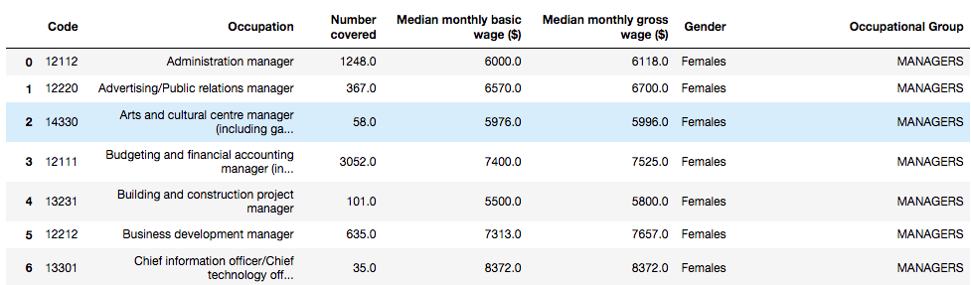
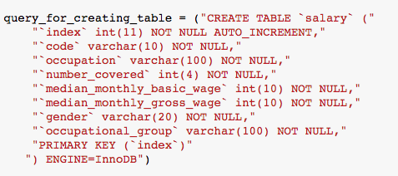
SALARIES
BEFORE TRANSFORMATION | After transformation
The transformed salary data was stored on an SQL database with the schema:
ANNEX

Slide 43
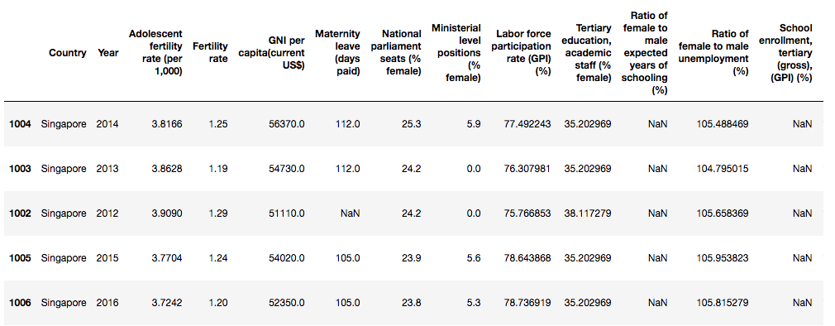
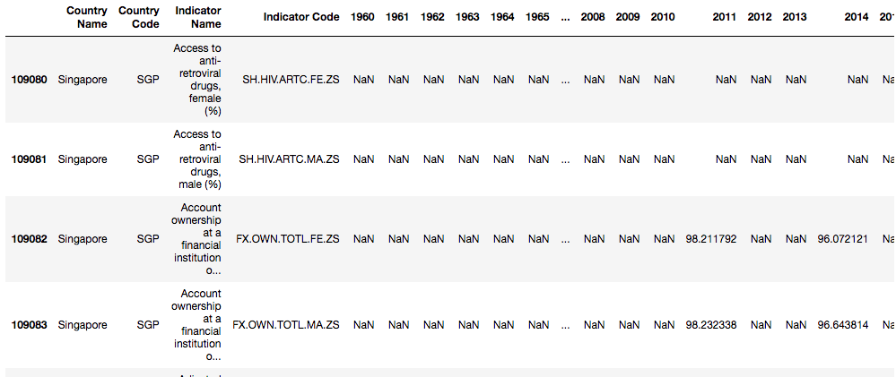
GENDER INDICATORS FROM WORLD DATA
GENDER INDICATORS FROM WORLD BANK DATA
Before transformation | After transformation
ANNEX

Slide 44
Definitions – selected world bank indicators

